Slide 1

U.S Income for 20th century

Slide 2

AGENDA
INTRODUCTION
Data Understanding
Data Cleaning
Handling Missing Values
FEATURE ENGINEERING
Data Analysis
Dash
ML Data preprocessing

Slide 3
INTRODUCTION
The dataset represent U.S. population data from the 20th century; the median income was approximately $50,000 for approximately 100,000 person.
Key Data Categories :
Demographics
Age.
Gender: Male and Female.
Race & Ethnicity: Includes White, Black.
Education
Education :Levels range from less than 1st grade to doctorate degrees
Education institution
Employment
Statuses: Full-time, part-time, unemployed, not in labor force.
Industries code: Manufacturing, retail, education, public administration, construction, finance, etc.
Occupations: From professional specialties to clerical, sales, machine operators, and more.
Marital
Household & Family
Citizenship & Migration
Income & Financials

Slide 4
DATA UNDERSTANDING
Index : 209499 entries
Data columns (total 43 columns)
Data type: float64(1), int64(12), object(30)
Numeric columns
 | age | employment_stat | wage_per_hour | working_week_per_year | industry_code | occupation_code | total_employed | vet_benefit | gains | losses | stocks_status | mig_year | importance_of_record
min | 0.0 | 0.0 | 0.0 | 0.0 | 0.0 | 0.0 | 0.0 | 0.0 | 0.0 | 0.0 | 0.0 | 94.0 | 37.87
max | 90.0 | 2.0 | 9999.0 | 52.0 | 51.0 | 46.0 | 6.0 | 2.0 | 99999.0 | 4608.0 | 99999.0 | 95.0 | 18656.30

Slide 5
DATA UNDERSTANDING
Categorical columns
ID | gender | education | class | education_institute | marital_status | race | is_hispanic | employment_commitment | unemployment_reason | is_labor_union | industry_code_main | occupation_code_main | household_stat | household_summary
count | 209499 | 209499 | 209499 | 104254 | 13302 | 209499 | 209499 | 209499 | 209499 | 6520 | 20079 | 209499 | 103805 | 209499
unique | 209499 | 2 | 17 | 8 | 2 | 7 | 5 | 10 | 8 | 5 | 2 | 24 | 14 | 38
top | ID_TZ99999 | Female | High school graduate | Private | High school | Never married | White | All other | Children or Armed Forces | Other job loser | No | Not in universe or children | Adm support including clerical | Householder
freq | 1 | 108784 | 50627 | 75617 | 7247 | 90723 | 175709 | 180404 | 129789 | 2242 | 16968 | 105694 | 15351 | 56195
under_18_family | veterans_admin_questionnaire | tax_status | citizenship | country_of_birth_own | country_of_birth_father | country_of_birth_mother | migration_code_change_in_msa | migration_prev_sunbelt | migration_code_move_within_reg | migration_code_change_in_reg | residence_1_year_ago | old_residence_reg | old_residence_state | income_above_limit
209499 | 57845 | 2084 | 209499 | 209499 | 209499 | 209499 | 209499 | 207911 | 121047 | 207911 | 207911 | 103215 | 16351 | 16351 | 209499
8 | 4 | 2 | 6 | 5 | 43 | 43 | 43 | 9 | 3 | 9 | 8 | 2 | 5 | 50 | 2
Householder | Both parents present | No | Nonfiler | Native | US | US | US | ? | ? | ? | ? | Same | South | California | Below limit
79470 | 40875 | 1684 | 78671 | 185669 | 185666 | 166968 | 168233 | 104696 | 104696 | 104696 | 104696 | 86864 | 5056 | 1849 | 196501

Slide 6
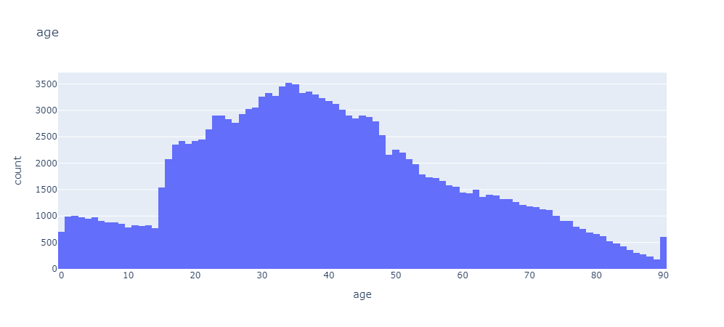
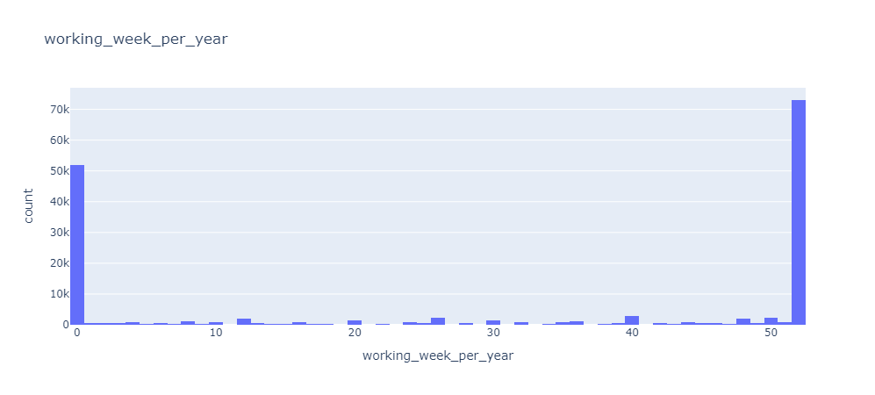
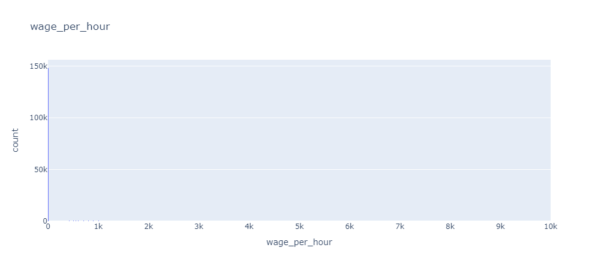
GRAPHS

Slide 7
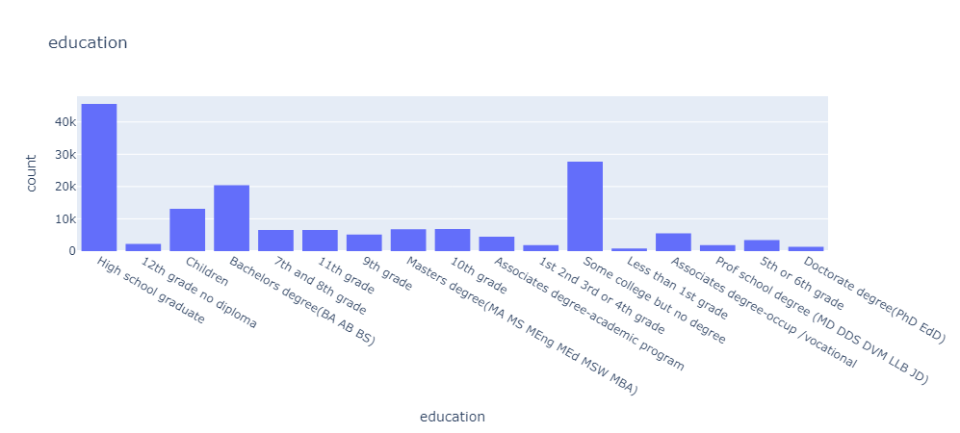
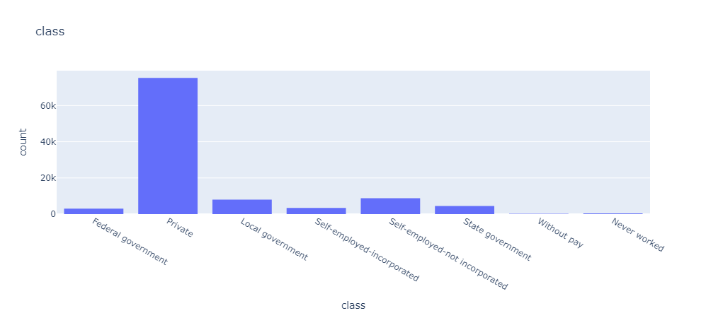
GRAPHS

Slide 8
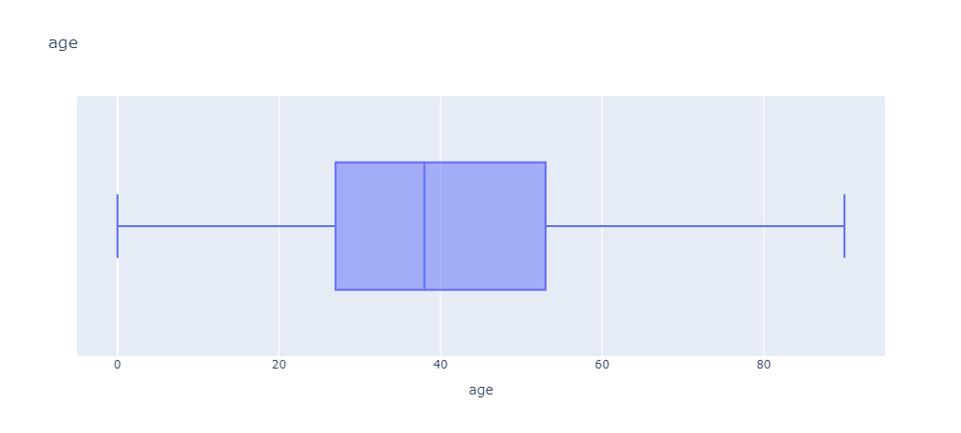
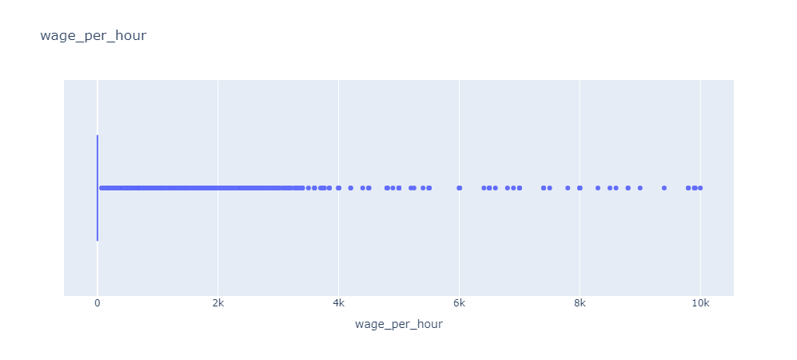
GRAPHS

Slide 9
DATA CLEANING
Dropping unnecessary columns :
ID
importance_of_record
Remove duplicates
Remove white spaces from categorical columns and show unique values
Fix ever and never in column household_stat :
household_stat=> Child 18+ never marr Not in a subfamily + Child 18+ ever marr Not in a subfamily change ever to never
Rename NA with don't know in is_Hispanic thy have same meaning
Change ? to Unknown : for 7 columns
Data type mismatching not exists

Slide 10
HANDLING MISSING VALUES
Missing data all of them is categorical :
veterans_admin_questionnaire | 98.71241
unemployment_reason | 95.97113
education_institute | 92.95509
old_residence_reg | 90.02648
old_residence_state | 90.02648
under_18_family | 88.43478
is_labor_union | 87.46753
residence_1_year_ago | 49.32186
migration_prev_sunbelt | 40.92817
occupation_code_main | 35.5018
class | 35.26264
migration_code_change_in_msa | 0.223549
migration_code_change_in_reg | 0.223549
migration_code_move_within_reg | 0.223549

Slide 11
HANDLING MISSING VALUES
Missing data all of them is categorical :
Drop columns >40
drop rows <5% after checking loss data percentage
veterans_admin_questionnaire | 98.71241
unemployment_reason | 95.97113
education_institute | 92.95509
old_residence_reg | 90.02648
old_residence_state | 90.02648
under_18_family | 88.43478
is_labor_union | 87.46753
residence_1_year_ago | 49.32186
migration_prev_sunbelt | 40.92817
occupation_code_main | 35.5018
class | 35.26264
migration_code_change_in_msa | 0.223549
migration_code_change_in_reg | 0.223549
migration_code_move_within_reg | 0.223549

Slide 12
HANDLING MISSING VALUES
FILL NAN VALUES
Class with Private most dominant category
Private 72.58
Self-employed-not incorporated 8.61
Local government 7.71
State government 4.33
Self-employed-incorporated 3.28
Federal government 2.96
Never worked 0.36
Without pay 0.17
occupation_code_main with Unknown
Adm support including clerical 14.87
Professional specialty 14.00
Executive admin and managerial 12.77
Other service 12.31
Sales 11.90
Precision production craft & repair 10.84
Machine operators assmblrs & inspctrs 6.34
Handlers equip cleaners etc 4.19
Transportation and material moving 4.12
Farming forestry and fishing 3.15
Technicians and related support 3.01
Protective services 1.63
Private household services 0.83
Armed Forces 0.04
migration_prev_sunbelt with Unknown
Unknown 83.12
No 10.64
Same 6.24

Slide 13
FEATURE ENGINEERING
Earning
wage_per_hour * working_week_per_year
Education level category
Primary Education
Secondary Education
High School Completion
Post-Secondary (Higher Education)
University Education

Slide 14
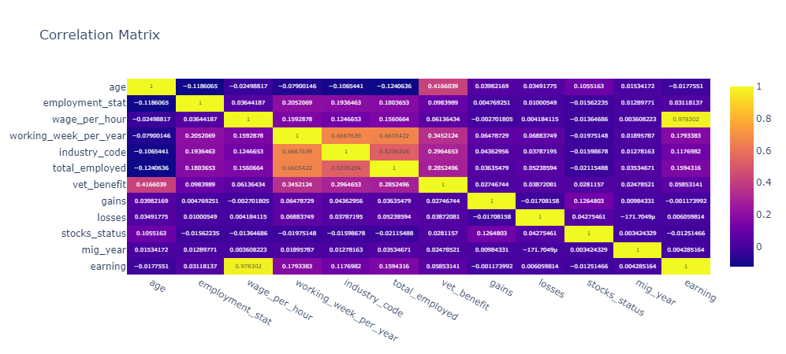
DATA ANALYSIS
Correlation : there is no strong relation ship between data except new generated earning column showing strong relation with wage_per_hour and this is a normal relation.

Slide 15
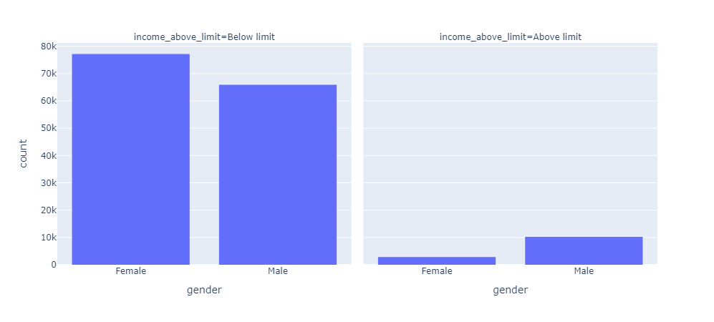
DATA ANALYSIS
Comparison of males and females earning over $50,000?

Slide 16
DATA ANALYSIS
Comparison of males and females earning over $50,000?

Slide 17
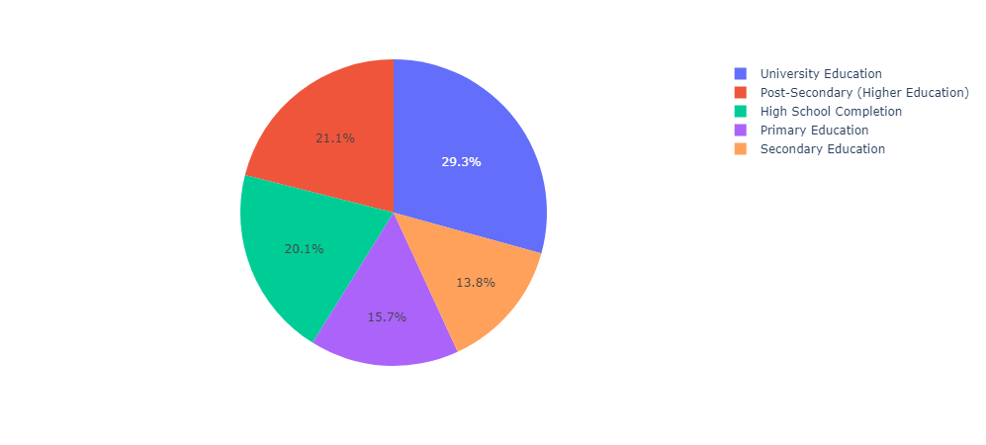
DATA ANALYSIS
Comparison between education level average earning ?
the university education came the first in earning compared to other education

Slide 18
DASH
Feature | Streamlit | Dash
Ease of Use | Very easy, minimal code required | Steeper learning curve
Customization | Limited | Highly customizable
Performance | Best for small-scale apps | Handles large datasets well
Interactivity | Widgets for input, graphs for output | Full interactivity with callbacks
Community | Growing rapidly | Established with rich resources

Slide 19
DASH
Why Dash for Interactive and Scalable Applications?
Interactivity: Dash uses callbacks to update components dynamically based on user input, making applications highly responsive.
Scalability: Dash applications can be deployed on cloud platforms, scaled across multiple users, and optimized for performance.
Customization: It integrates seamlessly with Plotly, allowing for rich, interactive graphs and visualizations.
Component-Based Architecture: Dash uses React.js under the hood, enabling modular and reusable UI components.
Deployment Flexibility: Dash apps can be hosted on local servers, cloud platforms, or enterprise solutions like Dash Enterprise.

Slide 20
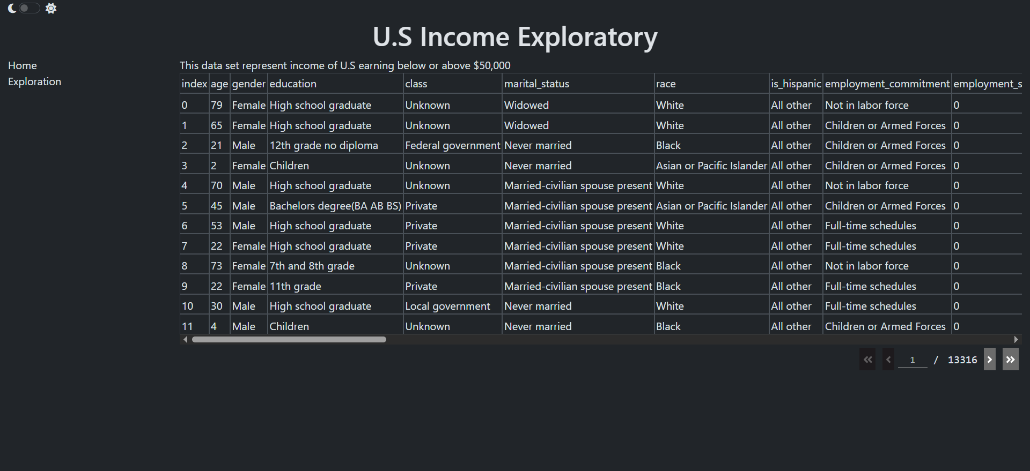
DASH

Slide 21
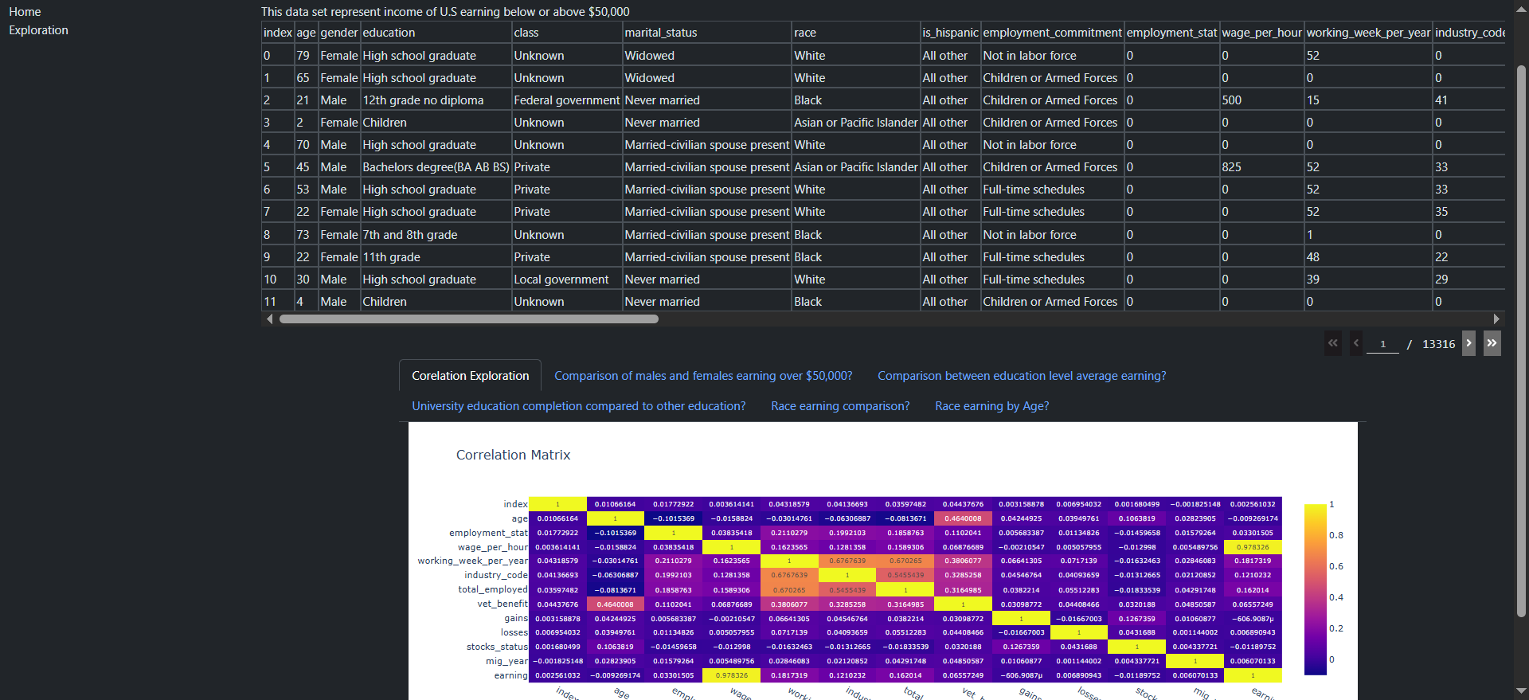
DASH

Slide 22
ML DATA PREPROCESSING
Same as data analysis stage till Feature engineering :
Drop education column replaced by education level
Drop education_institute same as education level
Split data to Train & Test
Check for imbalanced target due to classification for target column income_above_limit
Below limit 91.45
Above limit 8.55
Handling Numeric column
No missing value
Scaling using RobustScaler
Handling Categorical column
Missing value
Use SimpleImputer to handle missing value as same as handling missing data in data analysis phase
Encoding
OneHotEncoder
BinaryEncoder
Y train\test Encoding:
OrdinalEncoder to change it from text to 0-1
Handel imbalanced
Using SMOTE : 0 50% - 1 50%

Slide 23

THANK YOU

